Slide 1
DATA X-APPLIED DATA SCIENCE
TOPIC:-
CREDIT CARD FRAUD DETECTION MACHINE

Slide 2
PROJECT NAME:-CREDIT CARD FRAUD DETECTION MACHINE TEAM NO:-B2T9
TEAM MEMBERS:-
a)Parthib Ranjan Ray-RA1911003010664- pr6777@srmist.edu.in
(Phone no:-8208810054)
b)Vadireddy Kishore Kumar Reddy- vk5285@srmist.edu.in
(Phone No:-7995717191)
c)Shezin Saleem- ss6964@srmist.edu.in (Phone no:-8606805544)
d)Pendyala Nagi Kasi Sai Ram- ps1854@srmist.edu.in
(Phone No:-6309874945)
e)VagiCherla Sai Avinash- vs9010@srmist.edu.in (Phone No:-9912262725)
f)ChinThalapalle Ramanath Reddy- cr7246@srmist.edu.in
(Phone No:-9848225345)

Slide 3
NEED FOR CREDIT CARD FRAUD DETECTION MACHINE
In this new era of digital payments gaining momentum and a cashless world due to the current ongoing pandemic most of the payments have gone online rather than physical payments being the first choice in pre pandemic years
But as it is said every coin has two sides,credit card payments are highly risky and frauds can easily be committed by hackers and fraudsters to siphon off money from peoples account for their own personal gains.
So to combat this a fraud detection machine is put in place for banks to detect such frauds and counter it accordingly.

Slide 4
APPROACH OF IMPLEMENTING THE PROJECT
Dataset will be collected and will be analysed using data modelling,regression model etc
Then a decision tree model will be used to make a decision whether it is fraudulent or legal transaction using machine learning
Other techniques like neural networking and gradient boosting will be used.
The programming language will be R.
Dataset:-Credit card transaction list from data flair website(creditcard.csv)

Slide 5
BENEFITS:-
Machine Learning-based Fraud Detection:
Detecting fraud automatically
Real-time streaming
Less time needed for verification methods
Identifying hidden correlations in data

Slide 6
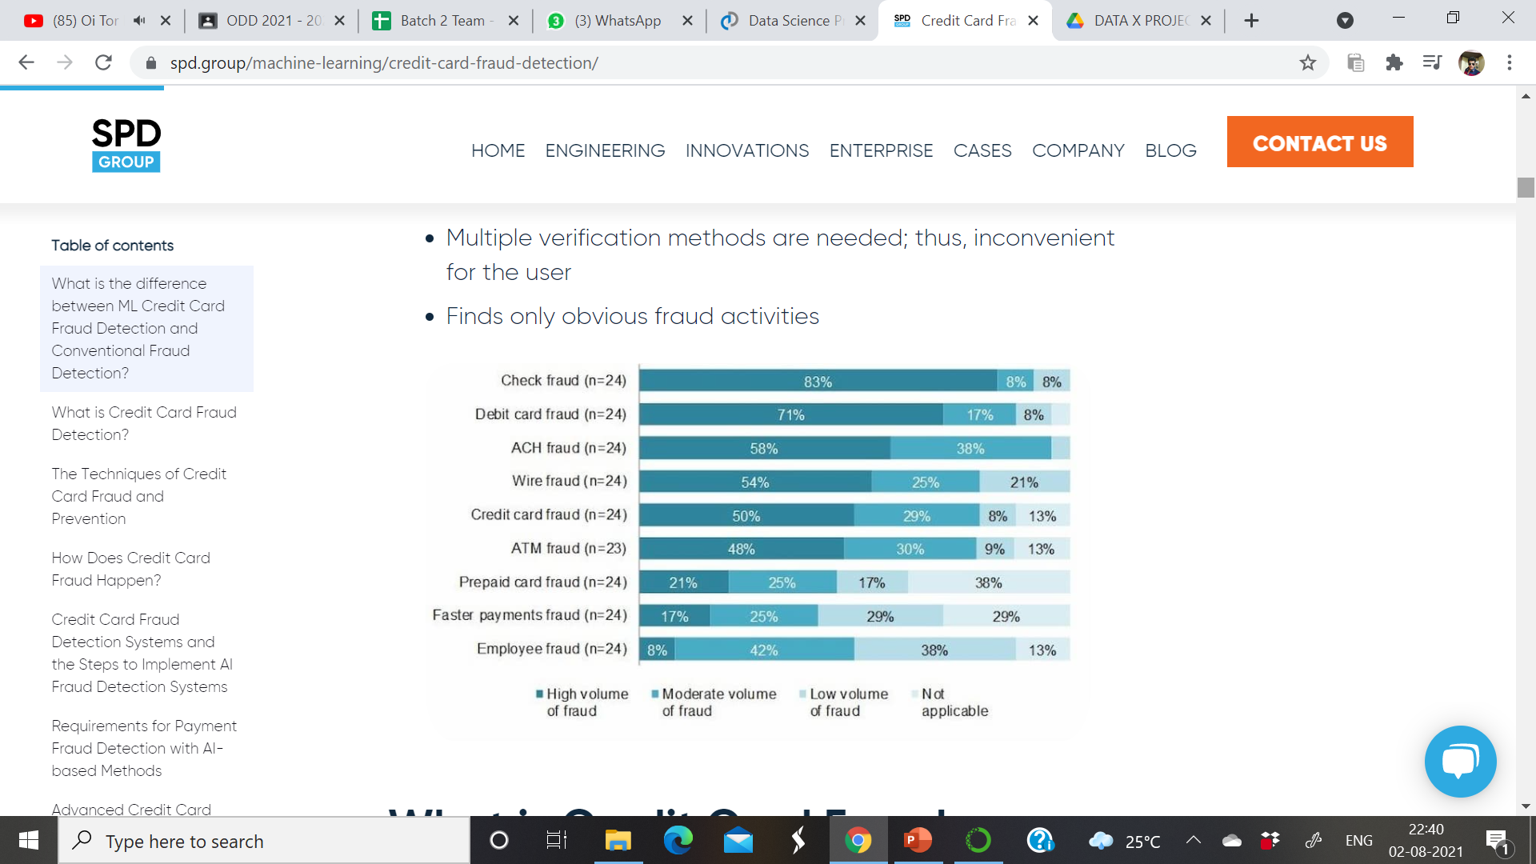
ALTERNATIVE:-
Conventional Fraud Detection:
The rules of making a decision on determining schemes should be set manually.
Takes an enormous amount of time
Multiple verification methods are needed; thus, inconvenient for the user
Finds only obvious fraud activities

Slide 7
REACTION TO THE PRODUCT:-
Unauthorized card operations hit an astonishing amount of 16.7 million victims in 2017. Additionally, as reported by the Federal Trade Commission (FTC), the number of credit card fraud claims in 2017 was 40% higher than the previous year’s number. There were around 13,000 reported cases in California and 8,000 in Florida, which are the largest states per capita for such type of crime. The amount of money at stake will exceed approximately $30 billion by 2020.
To prevent his from happening many industry leaders are vying for a robust credit card fraud detection software that will prevent this crimes from taking place and keeping fraudsters at bay.
Some banks like Standard Chartered,Barclays,Axis have strted using Machine learning systems for such purposes.

Slide 8
TO DO LIST:-
A)RESEARCH AND PRESENTATION – PARTHIB B)CODING AND FRONT END – KISHORE
C)DATASETS AND BACKEND – SAI AVINASH
D)GRAPHING AND NEURAL NETWORKING-SAI RAM
E)FINAL PROJECT TESTING-RAMANATH
F)DATA MINING AND DOCUMENTATION-SHEZIN SALEEM

